Slide 1
Subsystem Breakdown Description and Examples
Data Communication/Storage - Manny
-Sending data from ESP32 to database
-Choose method to send data ex. MQTT, HTTP
-Choose database to hold data ex. Local excel, influxDB, google sheets
Machine learning
Model & training data - Andrew
-ML model type used to disaggregate data ex. linear regression, decision trees
-Verifying model accuracy against existing models
-Finding source of reliable training data to compare against
Data Processing and Pipelining - Labib
- Getting external data sources (REDD, UKDale) into usable forms
-Preprocessing data before it goes to ML model ex. remove errors, add weather data from online
-Sending processed data to ML model from database
-Sending ML data from model back to database or website
Website/User interface - Ralph
-Displaying data on new website or existing dashboard ex. Grafana, sheets
-Allowing user inputs/view customization ex. input power cost, date range
-Could include how a users data is linked to them ex. over wifi, account login, user ID
-Option of mobile view

Slide 2
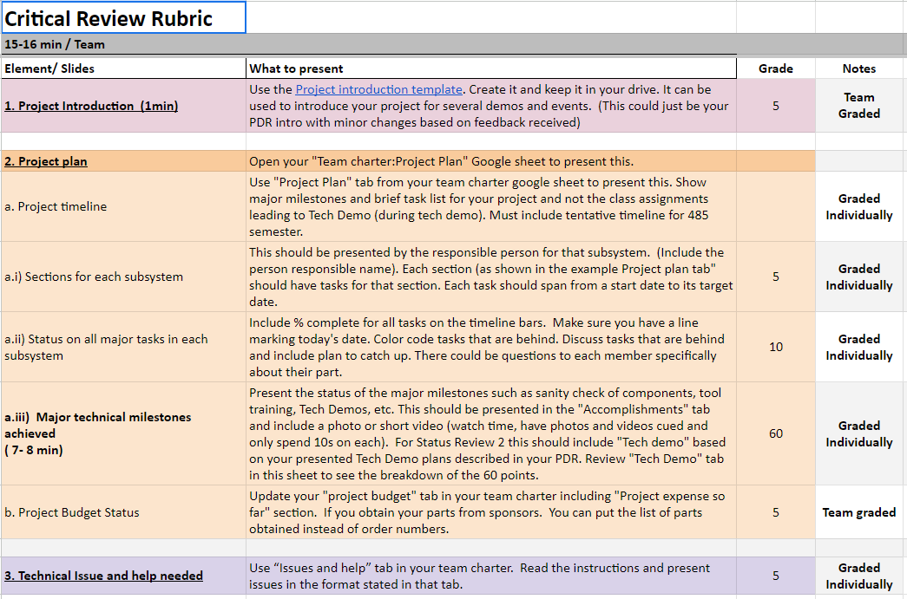
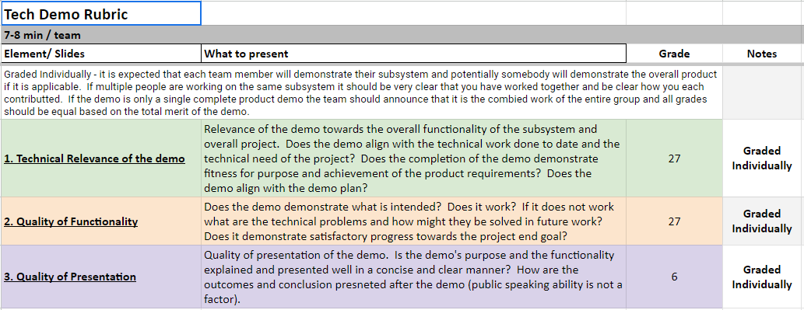
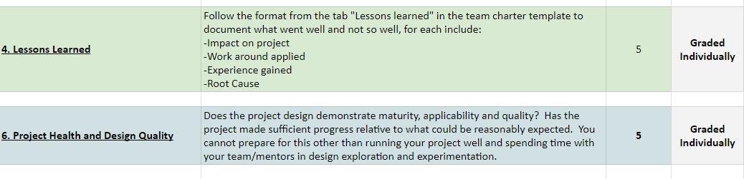
Status Review 2 & Tech Demo Rubrics

Slide 3
Critical Review
Residential Power Disagreggation Team 50
Team Members
Andrew Bailey, Ralph Cullom, Manny Harris, Labib Kasim
Mentor - Sponsor
Huangjie Gong - ABB

Slide 4
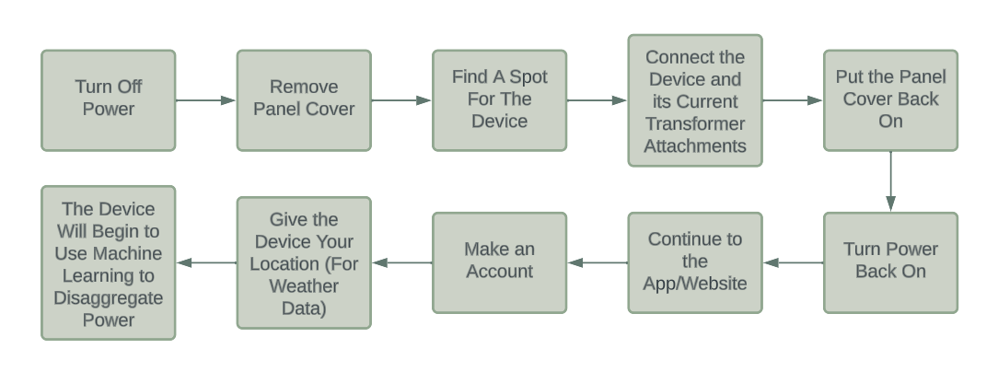
Project Introduction
Our project is creating a cost-effective, IoT-driven system to be employed by consumers which will disaggregate various residential loads. This device will incorporate machine learning and advanced data processing techniques to break down and forecast residential load across different categories based on the aggregated measurement, then display them for the user.
Key features:
Device measures lumped power usage of a household.
Data that the device collects should be sent wirelessly back to online data storage through IoT.
Machine learning algorithms will take the data and weather as inputs and output the disaggregated loads and predicted use.
Measured and predicted data will be displayed to the user.
Key constraints:
Final cost of the product should be no more than $100.
Device shall be small enough to fit neatly inside the residential panel.
Notes:
Andrew

Slide 5
Team Charter and Subsystems Tasks

Slide 6
Subsystem Tech
Demos

Slide 7
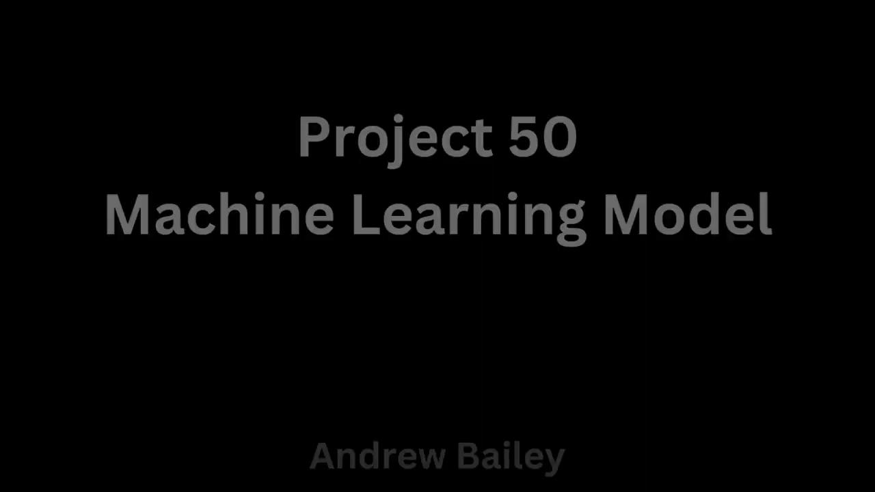
Andrew - Machine Learning Model

Slide 8
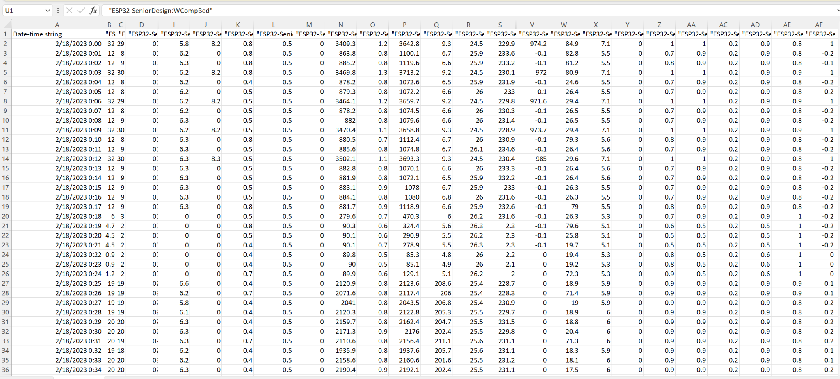
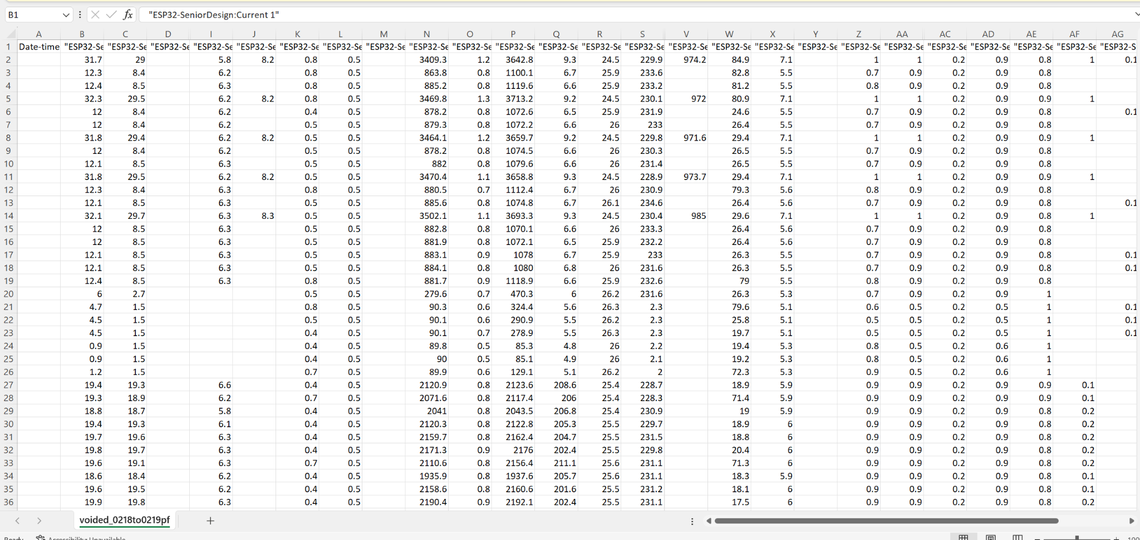
Labib - Data pre-processing
BEFORE AFTER

Slide 9
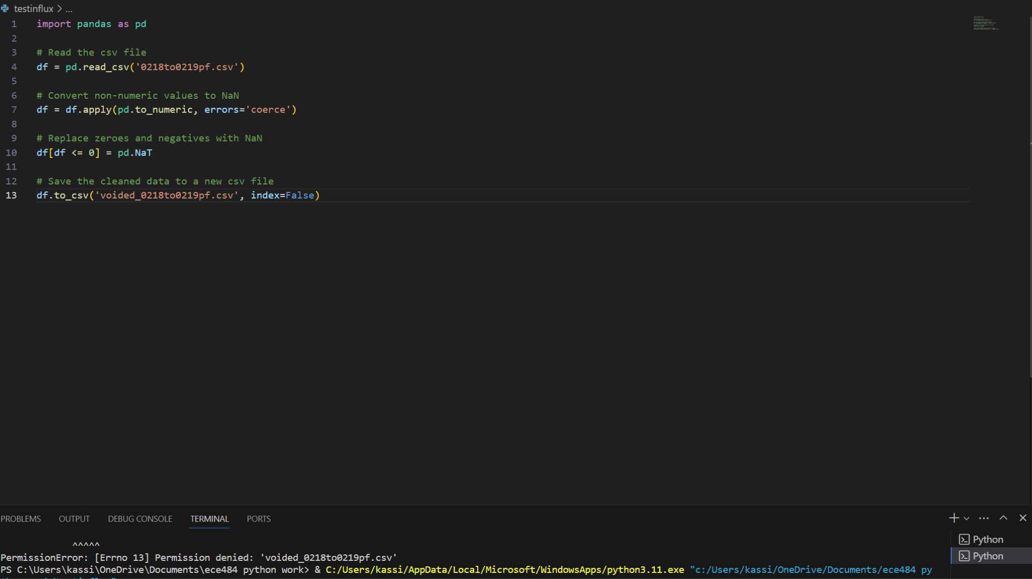
Snippet of code and problems currently
Code right now voids out all non-numeric values in file.
The date and time section shouldn’t be voided out
Notes:
Next steps:
Find an open source weather tool and figure out how to merge with data
Add up all columns giving individual power level of each appliance and get the total power utilized.

Slide 10
Manny - CT Measurements/Storage
Physical Demo

Slide 11
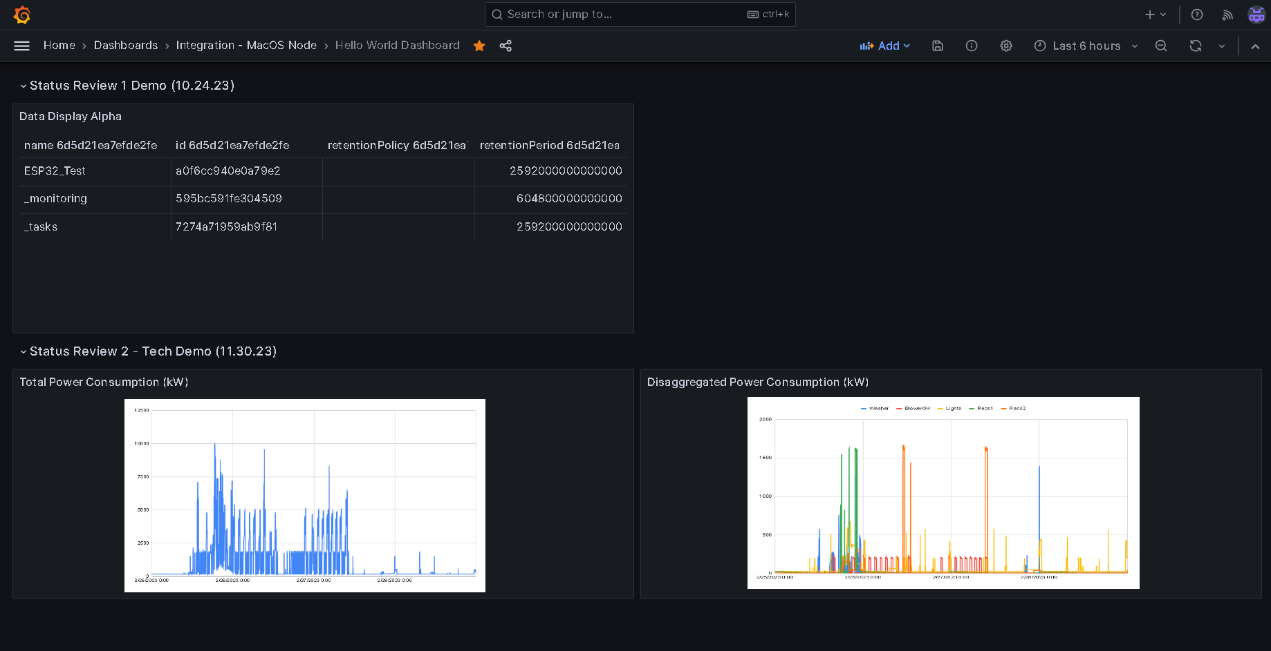

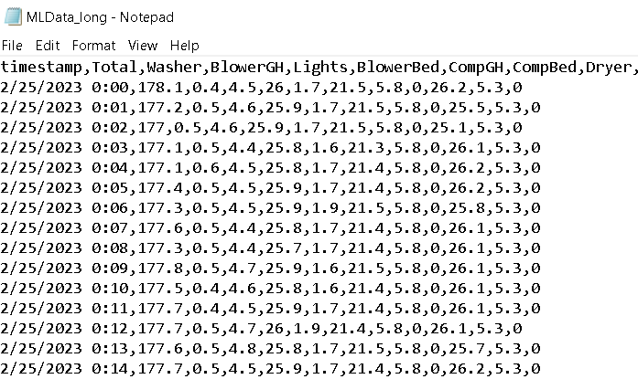
Ralph - Graphical User Interface

Slide 12
Questions
and
Discussion
Notes:
Slide template from slides.com

